Slide 1

Predictive Analysis of Crime Hotspots
G3T8
Nguyen Tuan Minh, Nanda Gian, Nguyen Vu Truong An, Bryan Bramaskara, Sebastian Hong
Notes:
title: predictive analysis of crime hotspots
problem statement: To understand the contributing factors responsible for the high crime rates in the US to assist in risk assessment methodologies in preventing future crimes

Slide 2
Content
01
02
03
04
05
PROBLEM & SOLUTION
OUR PROCESS
TARGET
Recap of Project Proposal
Dataset
Methods & Findings
Conclusion
Future Work

Slide 3
Problem Statement
To understand the contributing factors responsible for the high crime rates in the US to assist in risk assessment methodologies in the prevention of future crimes.

Slide 4

Motivation
America’s crime rate is above global average.
US prison population contributes to more than one-fifth of the global prison population, despite US accounting for only 5% of the world’s population.
Although there have been rigorous work dedicated to improve the accuracy of predictive policing, there are some drawbacks, such as being overly data-driven to the point that context is neglected.
Hence, in our project we will take context into consideration when carrying out analysis so that the predictions will be more accurate.
Attempt to lower crime rates by assisting in hazard identification (of potential criminals) in crime prevention efforts.

Slide 5

Literature Reviews
Literature Review
01
02
03
Crime Data Analysis Using Data Mining Techniques To Improve Crimes Prevention Procedures
Data Warehouse Framework
A Review of Data Mining Applications in Crime
Effectiveness of Data Mining Techniques previously employed in similar research on crime data
An Adaptive Approach For Analyzing And Predicting The Crime Location
Expert Opinions on methodologies used in crime analysis
External insight on additional techniques not taught in class

Slide 6

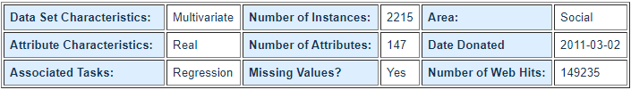
Dataset
Represents communities in the US.
Data combines socio-economic data from the '90 Census, law enforcement data from the 1990 Law Enforcement Management and Admin Stats survey, and crime data from the 1995 FBI UCR.
After removing less important columns (e.g. rental housing, pct of household with farm) and columns with more than 50% missing values, we ended up with a dataset that has a total of 50 columns.
https://archive.ics.uci.edu/ml/datasets/Communities+and+Crime+Unnormalized
VECTORS

Slide 7

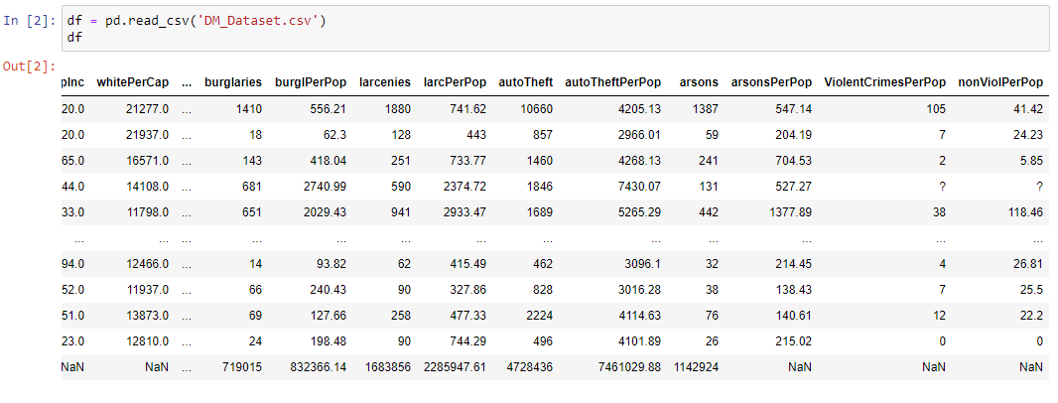
Data Cleaning

Slide 8

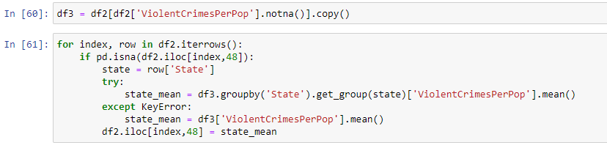
Data Cleaning
Change ‘?’ values to np.NaN
VECTORS
Replace the NaN values of the community based on the average of the stage that the community belongs to.

Slide 9

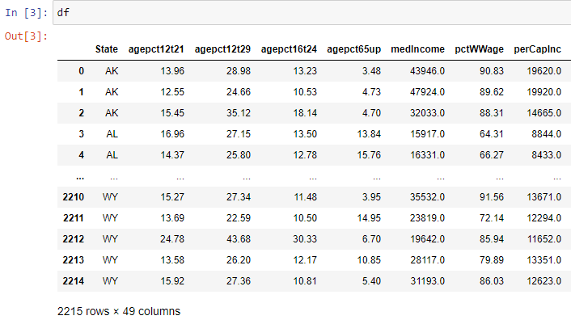
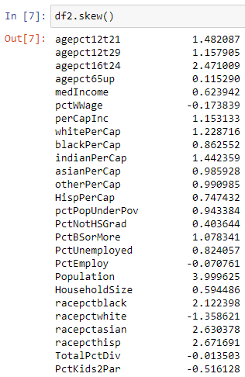
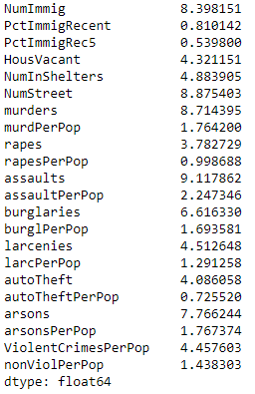
Data Preprocessing

Slide 10
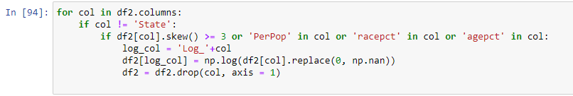
Data Preprocessing
Outlier Removal: Rows containing values that have Z-Score > 3 or Z-Score < -3 are removed.
VECTORS
Log transformation for group of columns that has high skewness (cells with 0 as value are replaced with np.NaN).
Standardisation: StandardScaler from sklearn

Slide 11
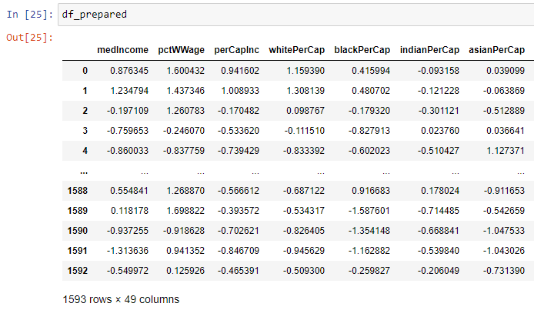
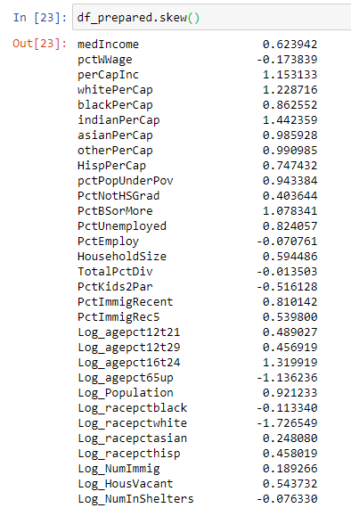
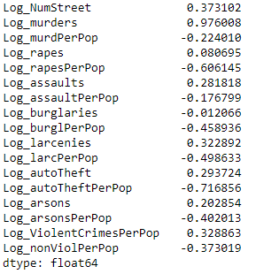
Data Preprocessing

Slide 12

Methods Used
MARS
NEPTUNE
Correlation Analysis
JUPITER
JUPITER
Outlier Analysis
Classification
Regression
Other Implementations (external methods)
Clustering

Slide 13
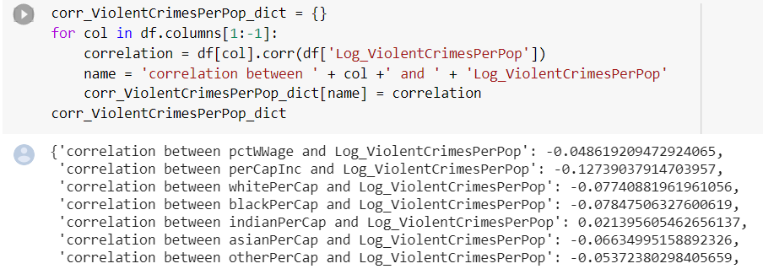
Correlation Analysis
Identify the association between variables
Help to choose variables for regression and classification models

Slide 14
Classification
Dataset: crime dataset after standardisation
Goal: predict the status of a community’s crime rate (either High or Low) given multiple external/internal factors.
Methods:
Tree-based Classification:
Decision Tree
Random Forest with/without Random Search for Hyperparameters Tuning
Gradient Boosting: XGBoost, LightGBMBoost, CatBoost
Bagging
Perceptron
Logistic Regression
Support Vector Machines (Linear and Non-linear)
Cross-validation: 10 folds cross validations on different models for more accurate results.

Slide 15
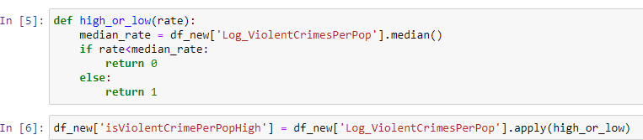
Data Preprocessing for Classification
Drop columns with more than 50% np.NaN values. Subsequently, drop the remaining np.NaN values.
Add Target Column: define functions to determine if the community has High or Low crime rate:
Train-Test Split:

Slide 16
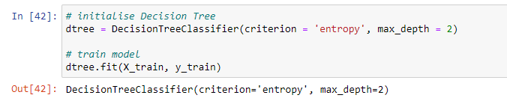
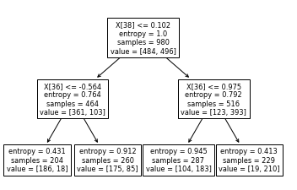
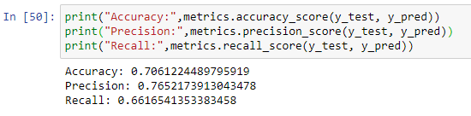

DECISION TREE
Initialise Decision Tree:
Visualise Decision Tree:
Performance:
Cross-validation Accuracy score:

Slide 17
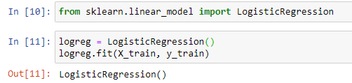
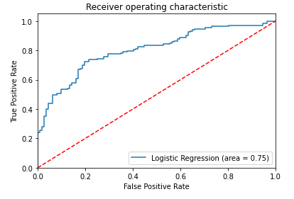
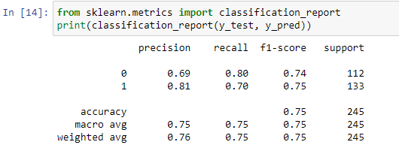
LOGISTIC REGRESSION
Initialise Logistic Regression:
ROC Curve:
Performance:
Cross-validation Accuracy score:

Slide 18
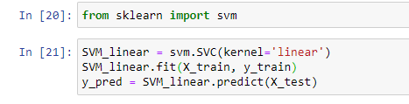

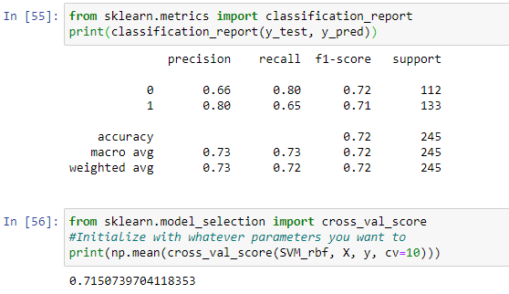
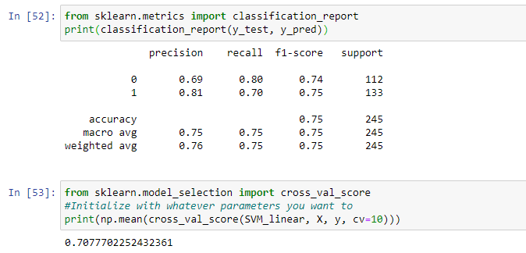
Support Vector Machine
Initialise SVM:
Performance:

Slide 19

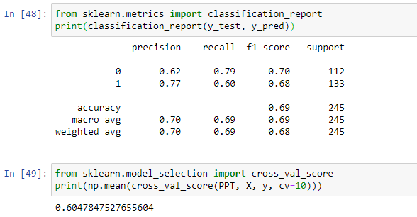
PERCEPTRON
Initialise Perceptron:
Performance:

Slide 20





Ensemble Methods Classifier
Bagging
Random Forest
XGBoost
AdaBoost
LightGBM

Slide 21
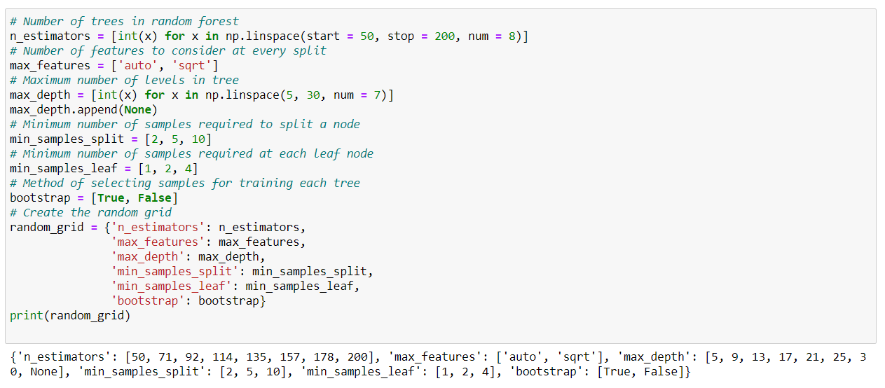
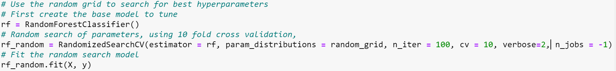
Random Forest Classifier with Random Search
Generate list of all possible parameters:
Cross validate on train set to get the model with the best combinations of parameters

Slide 22
Classification Results
Model | Cross validation Accuracy | Accuracy on test set
Bagging | 0.704 | 0.743
Random forest | 0.727 | 0.735
Random forest tuned with random search | 0.744 | 0.792
AdaBoost | 0.681 | 0.698
LightGBM | 0.691 | 0.792
XGBoost | 0.717 | 0.751

Slide 23
REGRESSION
Dataset: crime dataset after standardisation
Goal: predict the values of dependent variable (ViolentCrimePerPop) based upon values of independent variables.
Methods:
Linear Regression
Random Forest with/without Random Search for Hyperparameters Tuning
Gradient Boosting: XGBoost, LightGBMBoost, CatBoost
Bagging
Cross-validation: 10 folds cross validations on different models for more accurate results.
Notes:
Next, our group also did regression analysis on the crime dataset after performing standardization. Goal, methods, cross validation.

Slide 24
Data Preprocessing for Linear Regression
43 attributes after removing attributes with >50% null values, non-numerical attributes and attributes that are similar to each other.
11 attributes after removing attributes with absolute correlation values of <0.4 (weak correlation).
For both rounds of linear regression, we removed observations with null values and ended up with 1225 observations.
Notes:
Firstly for linear regression we reduced the no. of dimensions by removing some attributes. We did 2 rounds of linear regression, the first round with 43 attributes and the second round with 11 attributes. For both rounds…...

Slide 25
Data Preprocessing for Linear Regression
We performed 2 linear regression analysis on the dataset:
43 attributes after removing attributes such as
Attributes with >50% null values: Log_NumInShelters, Log_NumStreet, Log_murders, Log_murdPerPop
Non-numerical attribute: State
Attributes that are similar/have strong correlation: Log_nonViolPerPop as it has a strong correlation with Log_ViolentCrimesPerPop
11 attributes after removing attributes with absolute correlation values of <0.4 (weak correlation)
Log_assaultPerPop, Log_NumImmig, Log_rapes, Log_HousVacant, Log_burglaries, Log_arsons, Log_assaults, Log_Population, Log_larcenies, Log_autoTheft, Log_ViolentCrimesPerPop
Notes:
In greater detail, we perform 2 linear regression…...

Slide 26
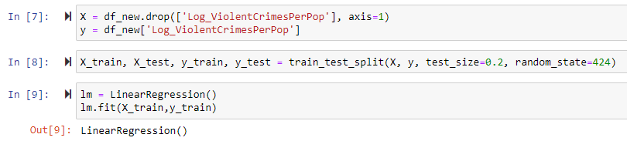
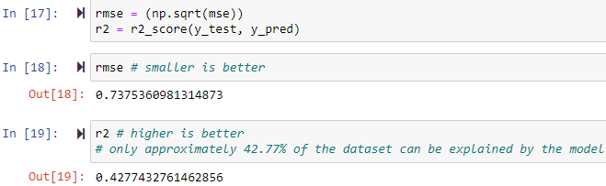
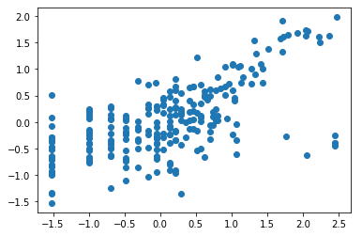
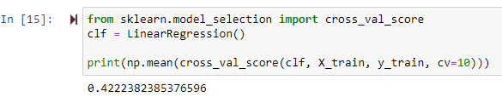
Linear Regression 1
Initialise Linear Regression Classifier:
Scatter Plot (y_test vs y_pred):
RMSE and R2:
Cross-validation Accuracy score:
Notes:
43 attributes
Rmse = 0.7375 (root mean squared error)
R2 = 0.4277
Cross validation score = 0.4222 better to focus more on this because it prevents overfitting while ensuring a good estimate of performance. Hence, it is able to give a less biased or less optimistic estimate of the model than other methods.

Slide 27
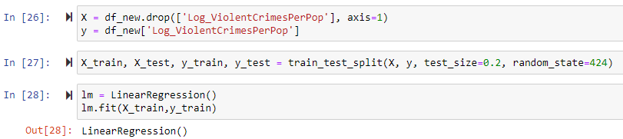
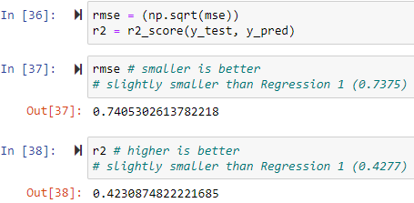
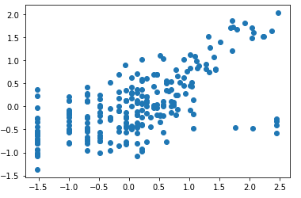
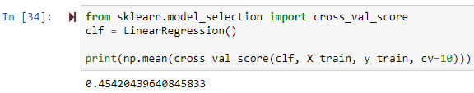
Linear Regression 2
Initialise Linear Regression Classifier:
Scatter Plot (y_test vs y_pred):
RMSE and R2:
Cross-validation Accuracy score:
Notes:
11 attributes
Rmse = 0.7405 (higher)
R2 = 0.4231 (about the same but slightly lower)
Cross validation score = 0.4542 (higher)
Relatively low R2 and cross validation score → from these results we can tell that → most attributes in the dataset don’t follow linear regression.

Slide 28
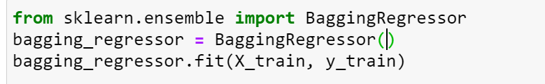
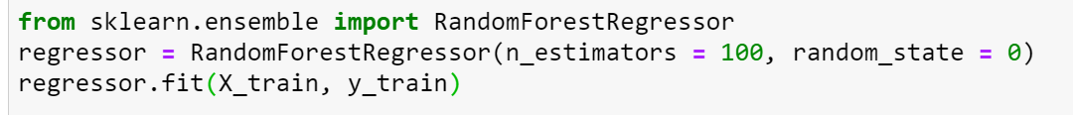
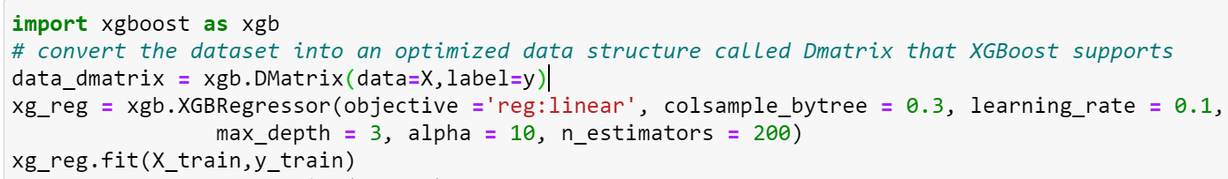
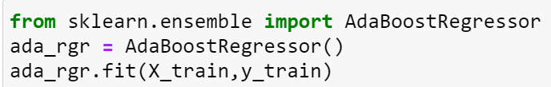
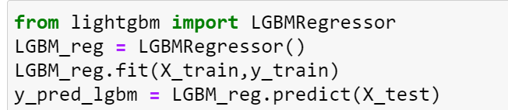
Ensemble Methods Regressor
Bagging
Random Forest
XGBoost
AdaBoost
LightGBM
Notes:
Next, we also implemented ensemble methods (similar to the ones in classification).
The only difference here is that we will be leveraging on r2 score for accuracy metric.
So we did bagging, random forest, xgboost, adaboost and lightgbm, and these are the implementation codes to initialise the regressors and then fit the train dataset and test dataset to the respective models.

Slide 29
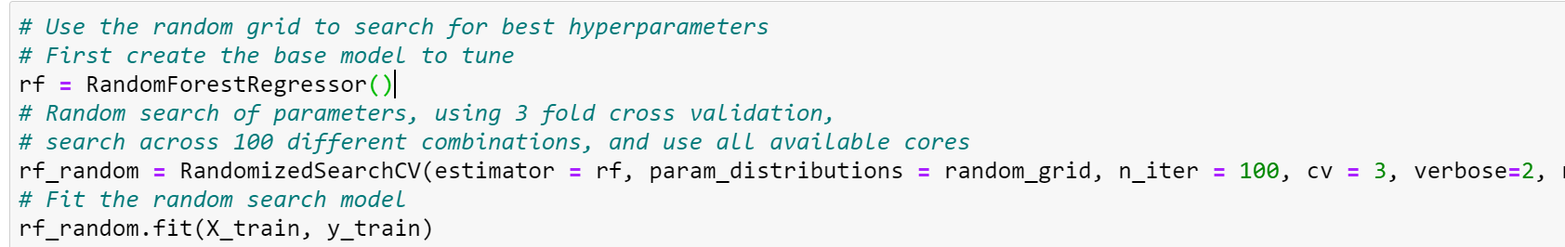
Random Forest Regressor with Random Search
Generate list of all possible parameters:
Cross validate on train set to get the model with the best combinations of parameters
Notes:
Random forest with random search is also performed. Tuning random forest is also the same as seen in classification.
First we generate a list containing all possible parameters, then we use the cross validation dataset to cross validate the train dataset to obtain the model with the best combinations of parameters that produces the highest cross validation accuracy score.

Slide 30
Regression results
Model | Cross validation Accuracy | Accuracy on test set
Bagging | 0.393 | 0.482
Random forest | 0.406 | 0.433
Random forest tuned with random search | 0.453 | 0.515
AdaBoost | 0.355 | 0.395
LightGBM | 0.397 | 0.475
XGBoost | 0.433 | 0.507
Notes:
Similar to classification, random forest tuned with randomized search gave the highest accuracy for cross validation set and test set.
Boosting and bagging showed decent results on the test set but did worse on cross validation set. This could be due to the fact that they overfitted and the boosting regressors focused too much on noise in the dataset.
Next I’ll pass on the time to Bryan.

Slide 31
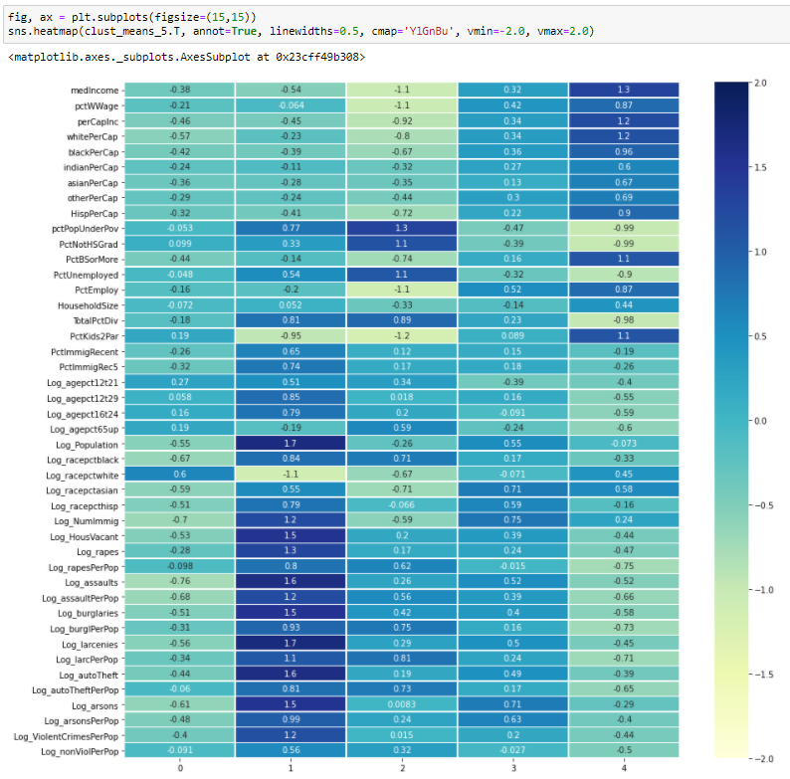
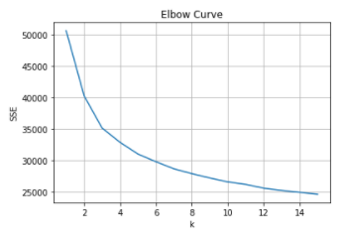

Clustering Analysis - All
Clustering Analysis for all attributes

Slide 32
Cluster Characteristics
Cluster | Distinct Characteristics | Remarks
0 | Relatively low income, low residence obtained bachelor degree, highest no. of white race, lowest no. of black race | Lowest Crime Rate
1 | Low income, high population under poverty, comparatively high rate of unemployed, lowest % of 2 parents living with their kid, high rate of divorce, very dense populated, high no. of black race, low no. of white race, high no. of immigrants, high no. of vacant house | Highest Crime Rate
2 | Lowest income, highest population under poverty, highest residence who never obtain bachelor degree, highest unemployment rate, highest divorce rate, not very dense populated state, high no of black race, low no. of white race | Comparatively high crime rate for raping, assault, burglary, larcenies and auto theft
3 | Relatively high income, obtain bachelor degree, very low unemployment rate, high no. of immigrant, high no. of asian race and hispanic race | Comparatively high crime rate for arson
4 | Highest income, most of the residence obtained bachelor degree, lowest population under poverty, highest employment rate, highest % of 2 parents living with their kid, lowest number of divorce, comparatively low no. of black race | Low Crime Rate

Slide 33
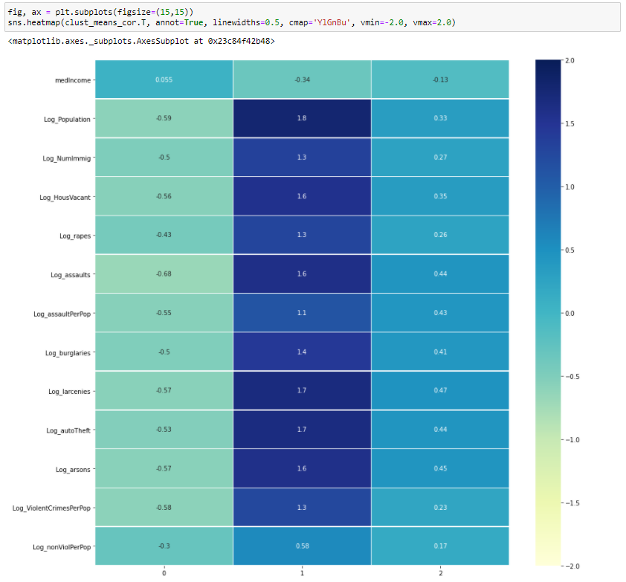
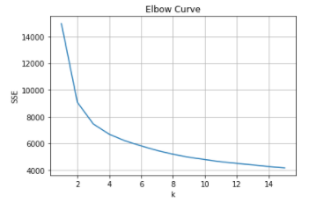

Clustering Analysis - Corr > |40%|
Clustering Analysis for attributes with corr > |40%|

Slide 34
Cluster Characteristics
Cluster | Distinct Characteristics | Remarks
0 | Relatively higher income, less dense populated state, low number of immigrants, low number of vacant houses | Lowest Crime Rate
1 | Lowest income, very dense populated state, highest number of immigrants, highest number of vacant houses | Highest Crime Rate
2 | Relatively lower income, more dense populated state, relatively higher number of immigrants and number of vacant houses | Moderate Crime Rate

Slide 35

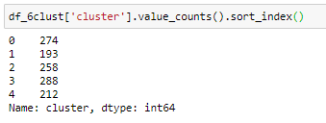
Cluster States
All Attributes
Cluster 0
States: MI (9.5%), MN (8.8%), OH (8%), PA, WI, etc.
Cluster 1
States: CA (23.8%), TX (10.9%), FL (6.2%) , NC, VA, etc.
Cluster 2
States: TX (13.2%), MI (6.2%), NC (6.2%), OK, CA, etc.
Cluster 3
States: CA (23.6%), NJ (13.5%), MI (7.3%), TX, MA, etc.
Cluster 4
States: NJ (18.8%), PA (9.9%), IL (9%), MN, CT, etc.
Corr > |40%|
Cluster 0
States: NJ (9.5%), TX, PA, MN, OH, MI, MA, etc.
Cluster 1
States: CA (23.7%), TX, FL, MI, etc.
Cluster 2
States: CA (14.8%), NJ, MI, TX, MA, FL, OH, etc.

Slide 36

Conclusion
Random Forest tuned with random search achieves the highest accuracy score for both Classification and Regression.
Why is it suitable?
Works well with non-linear data
Less prone to overfitting
Runs efficiently with a large dataset (1593 rows x 49 columns)
Cons:
Hyperparameter tuning is time consuming as it relies on experimental results
Harder to tune, compared to other models, as many K-Fold cross validation iterations to be done
Notes:
settings of the algorithm to be adjusted to optimize performance
Hyperparameters to be fine-tuned to produce optimal results

Slide 37
Conclusion
Clustering analysis gave a lot of insights or characteristics for states that have higher crime rates due to the attributes, such as:
Densely Populated State
High No. of Population Living Under Poverty
High Rate of Divorce
Low Rate of Children Living with 2 Parents (under the same house)
High No. of Immigrants
Relatively High Young Adult Population
High No. of Black Race Resident
Low No. of White Race Resident
High No. of Vacant Houses
Notes:
*Read From slide* 9 add with - but the most distinct attributes are number of black race, unemployment rate, number of white race and divorce rate which will determine the low or high crime rates.

Slide 38
Future Works
PCA
Derive components to maximize variance in dataset while reducing variables
Collinearity Testing
Checks for correlation between predictor variables
To produce more stable regression estimates and lower standard errors
Regularized Linear Regression
To understand more about the relationship between evaluation metrics and model complexity
Lasso Regression
To minimise prediction error (enhance prediction accuracy)
Encourages simple and sparse models (tackles the Curse of Dimensionality)
Helps to better determine which of the predictors are most important
Not implemented due to time constraint and/or lack of expertise.
Notes:
Multicollinearity can also be detected with the help of tolerance and its reciprocal, called variance inflation factor (VIF). If the value of tolerance is less than 0.2 or 0.1 and, simultaneously, the value of VIF 10 and above, then the multicollinearity is problematic.
Regularized regression is a type of regression where the coefficient estimates are constrained to zero. The magnitude (size) of coefficients, as well as the magnitude of the error term, are penalized. “Regularization” is a way to give a penalty to certain models (usually overly complex ones) → prevents overfitting.
LASSO stands for Least Absolute Selection Shrinkage Operator wherein shrinkage is defined as a constraint on parameters. The goal of lasso regression is to obtain the subset of predictors that minimize prediction error for a quantitative response variable. The algorithm operates by imposing a constraint on the model parameters that causes regression coefficients for some variables to shrink toward a zero. → helps analysts to determine which of the predictors are most important.

Slide 39
Thank you!
Q&A
Notes:
training of data to extract components to explain the variance
LASSO stands for Least Absolute Selection Shrinkage Operator wherein shrinkage is defined as a constraint on parameters. The goal of lasso regression is to obtain the subset of predictors that minimize prediction error for a quantitative response variable. The algorithm operates by imposing a constraint on the model parameters that causes regression coefficients for some variables to shrink toward a zero. → helps analysts to determine which of the predictors are most important.
Limitation of our work + other methods that can be potentially useful wrt prob statement but not implemented now (beyond resources avail/lack expertise/software/time)

